Slide 1

JAVA PROJECT
JAVA
MOVIE WEBSITE
(LIKE NETFLIX)
By:
-Jay Bhattarai (1BM19IS198)
-Sachin Madhesiya (1BM19IS206)

Slide 2
ABSTRACT
-EVERYONE LIKE NETFLIX, MOVIE WEBSITE, MOVIE RECOMMENDATION AND RATING WEBSITE LIKE IMDB.
-WE HAVE ATTEMPTED TO CREATE SUCH APIS USING JAVA SPRING AND MYSQL DATABASE.
-WE HAVE CREATED A NETFLIX LIKE WEBSITE, BUT TO DISPLAY ABOUT THE MOVIE

Slide 3
INTRODUCTION
-This movie site contains basic information on the movie, release date of movie, genre, studio etc
-Allows the user to perform a number of queries on the database to extract information.
-For example The user can search for specific movies of choice in terms of genre.

Slide 4
LITERATURE SURVEY
-PEOPLE OFTEN TENDS TO WATCH MOVIES OF SOME SPECIFIC GENRES OR THE MOVIE RECOMMENDED BY OTHER PEOPLE. SO, FOR A MOVIE STREAMING WEBSITE TO RUN CUSTOMER SATISFACTION IS MUST NEEDED.
-CREATING A MOVIE RECOMMENDATION APP, THE APP HAS TO PROVIDE GOOD SERVIES TO THE USERS WHO ARE USING THE APPLICATION. A GOOD MOVIE RECOMMENDATION APP HELPS THE USER TO FIND THE MOVIE THAT THEY LIKE AND HELPS THE COMPANY TO GROW

Slide 5
EXISTING SYSTEM
-IMDB has no apis for public
-Other services like TMDB and OMDB costs a lot of money and free quota provides only specific amount of request per minute
-Complex usability
PROPOSED SOLUTION
-Provides public apis
-Free api request for any number of queries made by the application
-Simple Usability

Slide 6
METHODOLOGY
-JAVA FOR HANDLING ALL THE BACKEND ROUTING AND MANAGING THE APPLICATION STATE
-MYSQL FOR THE DATABASE
-JAVASCRIPT FOR BUILDING THE FRONTEND WEB UI
-JAVA SPRING TO INTEGRATE DIFFERENT MODULES AND WORKS AS A MIDDLEWARE TO PROVIDE REQUIRED INFORMATION FROM FRONTEND TO BACKEND AND BACKEND TO FRONTEND

Slide 7
-JDBC (JAVA DATABASE CONNECTIVITY) TO CONNECT THE DATABASE AND THE APPLICATION, FOR CRUD OPERATION.
-JAVA PERSISTENCE API TO PERSISTENTLY STORE THE VAST AMOUNTS OF DATA INTO A DATABASE .
-POSTMAN TO HANDLE ALL THE CRUD REQUESTS LIKE(GET, POST, PUT, DELETE)

Slide 8
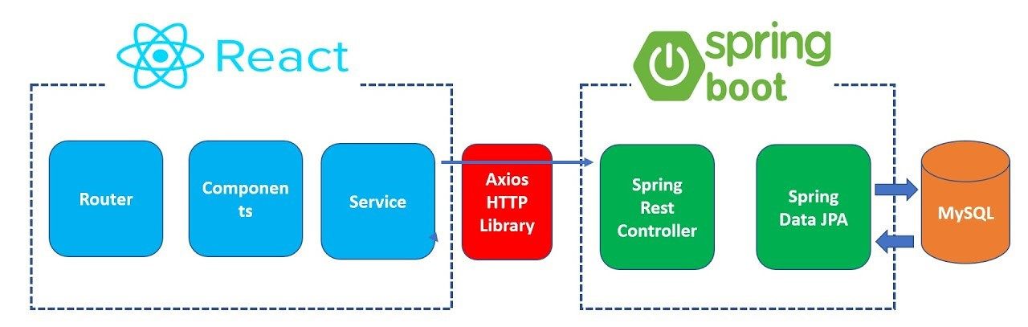
ARCHITECTURE

Slide 9
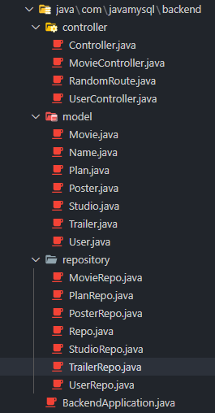

CODE STRUCTURE
Controller
-To control the routes
Model
-Database Models
Repository
-Fetching required data from DB

Slide 10

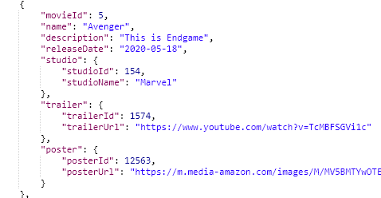
WORKING

Slide 11
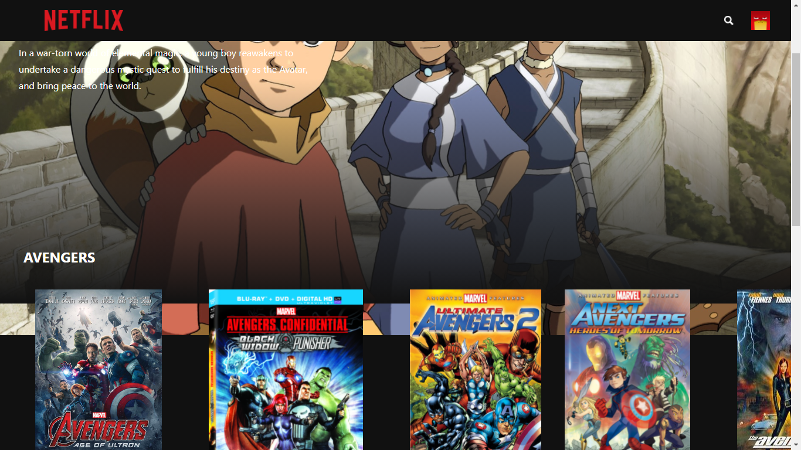

Slide 12


TOOLS USED
Programming languages, framework and libraries
-JAVA
-Spring Boot
-JPA
-My SQL Connector
-Maven (Java build Automation Tool)
-JAVASCRIPT
-React JS (for frontend ui)
-Axios (for frontend request handle)
-MYSQL
-POSTMAN (for CRUD Operation)

Slide 13
THANK YOU!

